Slide 1
The Wellbeing Collaborative
of Arizona Health Professionals

Slide 2
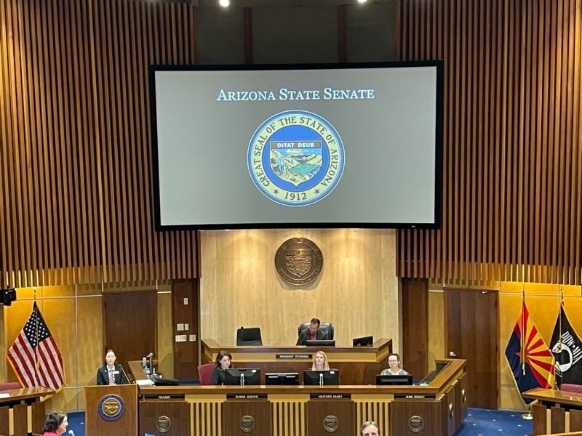
March 18th - Health Workforce Well-Being Day

Slide 6
THE ARIZONA HEALTH & HEALTHCARE WORKFORCE
Prior to the pandemic, health systems and practices were grappling with provider/employee burnout, prompting organizations to seek out key drivers and solutions.
The emergence of COVID-19 led physician leaders in Arizona to unite and address the public health emergency collectively.

Slide 7
AUTHENTICITY, CLARITY, AND TRUST (ACT) IN BUILDING PARTNERSHIPS DURING THE COVID-19 PANDEMIC
Structured engagement improved access to care
Unprecedented transparency was achieved, resulting in…
Arizona’s health service infrastructure was able to address statewide clinical needs
Combination of clinical experiences allowed for early recognition of trends
Statewide standards of care such as visitation policies & testing strategies were promoted
Alignment of recommendations enabled a more impactful voice at county & state levels
Workforce health & burnout was monitored, and key drivers identified

Slide 8
THE ARIZONA HEALTH & HEALTHCARE WORKFORCE
This culminated in the creation of the Wellbeing Collaborative in 2021, which aimed to bring together thought leaders and innovative ideas.
This momentum led to the formal establishment of the Wellbeing Collaborative of Arizona Health Professionals, further solidifying the commitment to combat provider burnout and enhance the overall wellbeing of health professionals in the region.

Slide 9
KEY LEADERSHIP
Strategic Advisors
Steering Council
The Strategic Advisors are leaders and executive who graciously share their expertise and feedback on strategic initiatives, ideas, proposals, or programs for the collaborative and leverage their network to help move work forward.
The Steering Council is a leadership group across major participating organizations who graciously share their time and expertise to meet regularly and discuss strategic initiatives and action items around ideas, proposals, or programs for the collaborative.
Alison Essary, Professor & Chair, Dept of PA Studies, NAU-Phoenix
Beth Kohler, Owner, Beth Kohler Consulting LLC
Holly Ward, Vice President of Communications, Arizona Hospital and Healthcare Association (AzHHA)
Keith Frey, Principal Consultant and Coach, Frey Healthcare Consulting
Lorenzo Martinez, Senior Director of Health Sciences, Arizona Board of Regents
Mark Carroll, CMO, BCBSAZ Health Choice
Theresa Cullen, Department Director, Pima County
Vince Berkley, Retired Assistant Surgeon General, NARBAH Institute
Carisa Bamford, Clinician Experience & Development Sr. Dir., Banner Health
Charlton Wilson, Consultant, Transformational Fellow, NARBHA Institute
Cindy Martin, Transformation Fellow, NARBHA
Cynthia M. Stonnington, Associate Medical Director of the Office of Joy and Well-Being , Mayo Clinic
Heather Rabin, Sr Advisor Wellbeing and Professional Development, Dignity Health, CommonSpirit Health
Heidi Sanborn, President, Arizona Nurses Association
Jasleen Chhatwal, Chief Medical Officer, Sierra Tucson, University of Arizona
Jen Hartmark-Hill, Full-Time Professor, University of Arizona/ArMA
Kurt Mueller, Transformation Fellow, NARBHA
Mary Jo Gregory, President & CEO, NARBHA Institute
Michelle Villegas-Gold, Director of Health and Clinical Research, Arizona State University
Rebecca Sunenshine, Medical Director, Maricopa County Department of Public Health
Scott Sharples, Executive Director, Care Management, Banner Health
Sheila Sjolander, Assistant Director, Arizona Department of Health Services
Teresa Bertsch, CMO/CWO, NARBHA Institute
Tiffany Pankow, Chief of Caregiver Wellness and Patient Experience, Honor Health
Experts
The Experts are leaders and executive who graciously share their expertise (as it makes sense) on strategic initiatives and programs for the collaborative.
Stephen J. Swensen, Transformational Fellow (NARBHA Institute), Senior Fellow (Institute for Healthcare Improvement)
Stuart Goodman, Principal at Goodman-Schwartz Public Affairs

Slide 10
IMPACT
Sept 29, 2023 - Hosted a world class Wellbeing Summit with 200+ executive leaders, health professionals, and administrators to learn, share, and envision a healthier ecosystem
Designed, developed, and delivered 18 monthly newsletters to inform and engage the collaborative community, with complete with impact stories from leaders
Hosted 8 Strategic Storytelling workshops attended by 60+ health professional leaders and administrators
Notes:
We need your help, let us know who we can work with as we begin to build a schedule

Slide 11
ENGAGEMENT
MONTHLY NEWSLETTERS AND STORIES
www.wellbeingcollaborative.org

Slide 12
VALUE OF MEMBERSHIP
membership provides access to repository of best practices
ability to highlight your individual or organizational work
access to experts in the field affiliated with the Collaborative
Join the Collaborative and to be an Architect of Change !
https://wellbeingcollaborative.org/

Slide 13
TRANSFORMATIVE POWER OF COLLABORATION
Individual – 260+
Organizational – 68+
Statewide
National

Slide 14
STRATEGIC RETREAT SUMMARY
1/24/2025
NORMALIZE
WELLBEING
CONSISTENCY & LEARNING MINDSET
KEEP THE MOMENTUM GOING
Themes
SUSTAINABILITY
FACILITATING IMPLEMENTATION
INCLUSIVE & INTERPROFESSIONAL
People are looking to the Collaborative for recommendations.
LEADERSHIP DEVELOPMENT FOCUSED ON WELLBEING
Inform. Equip. Convene.

Slide 15
STRATEGIC INITIATIVES
Transforming workforce development and sustainability.
Supporting the creation of BRAVE spaces for open & honest dialogue and ideas.
This initiative is dedicated to transforming workforce development and sustainability within the health ecosystem, placing a strong emphasis on enhancing health professional wellbeing. By implementing innovative strategies and initiatives, we aims to equip future health professionals with the skills, tools, and mindsets that promote wellbeing, ensure long-term career sustainability and contribute to high-quality patient care.
This initiative prioritizes best practices and frameworks that promote brave spaces for health professionals that provides them with an environment where they can engage in open and honest dialogue, facilitating discussions about their wellbeing and allows for the free expression of ideas to support their mental, physical, spiritual, and emotional health.
Led by: Michelle Villegas-Gold, Director of Health and Clinical Research, Arizona State University
Action Item: Implementation and facilitation of a bespoke leadership program
Led by: Cynthia M. Stonnington, Associate Medical Director of the Office of Joy and Well-Being , Mayo Clinic
Action Item: Toolkit for leaders to craft BRAVE spaces for open and honest dialogue.
Championing legislation awareness and policy change.
Making the Case for Wellbeing
This initiative takes a proactive stance in championing legislation awareness and policy change that directly impacts health professional wellbeing. By advocating for reforms that prioritize healthcare workforce support, we aims to bring about meaningful changes in policies that address key issues such as work-life integration, burnout prevention, mental health support, and fair working conditions, ultimately promoting the overall wellbeing and resilience of healthcare professionals.
Recognizing the pivotal role of evidence-based advocacy, this initiative is dedicated to consolidating a comprehensive repository of reports, literature, studies, and pivotal data that underline the return on investment (ROI) in well-being. As a collective, members meticulously curate and refine this information, to confidently present and advocate for well-being initiatives to their leadership, ensuring that the case for well-being is both compelling and grounded in robust evidence.
Co-Led by:
Tiffany Pankow, Chief of Caregiver Wellness and Patient Experience, Honor Health
Jasleen Chhatwal, Chief Medical Officer, Sierra Tucson, University of Arizona
Action Item: A statement on behalf of the Wellbeing Collaborative that educates the legislature on the importance of workplace wellbeing
Led by: Carisa Bamford, Clinician Experience & Development Sr. Dir., Banner Health
Action Item: Repository of data and stories to be used and shared for “making the case”.

Slide 16
Thank you!

