Slide 1
Health Information and Misinformation During COVID-19:
What Can We Believe?
October 22, 2020
Swapna Reddy, JD, DrPH, MPH
Clinical Assistant Professor
ASU, College of Health Solutions
CHS Health Talks

Slide 2
Highly Infectious Virus
+
Misinformation
=
Perfect Storm
Phenomenon not new to COVID-19
Contributing Factors:
  Lack of information
  Mixed messaging
  Conflicting sources of information
  Inconsistent policies
  Diminishing value of “expertise”
Recent examples:
  Ebola
  Mandatory school vaccinations

Slide 3
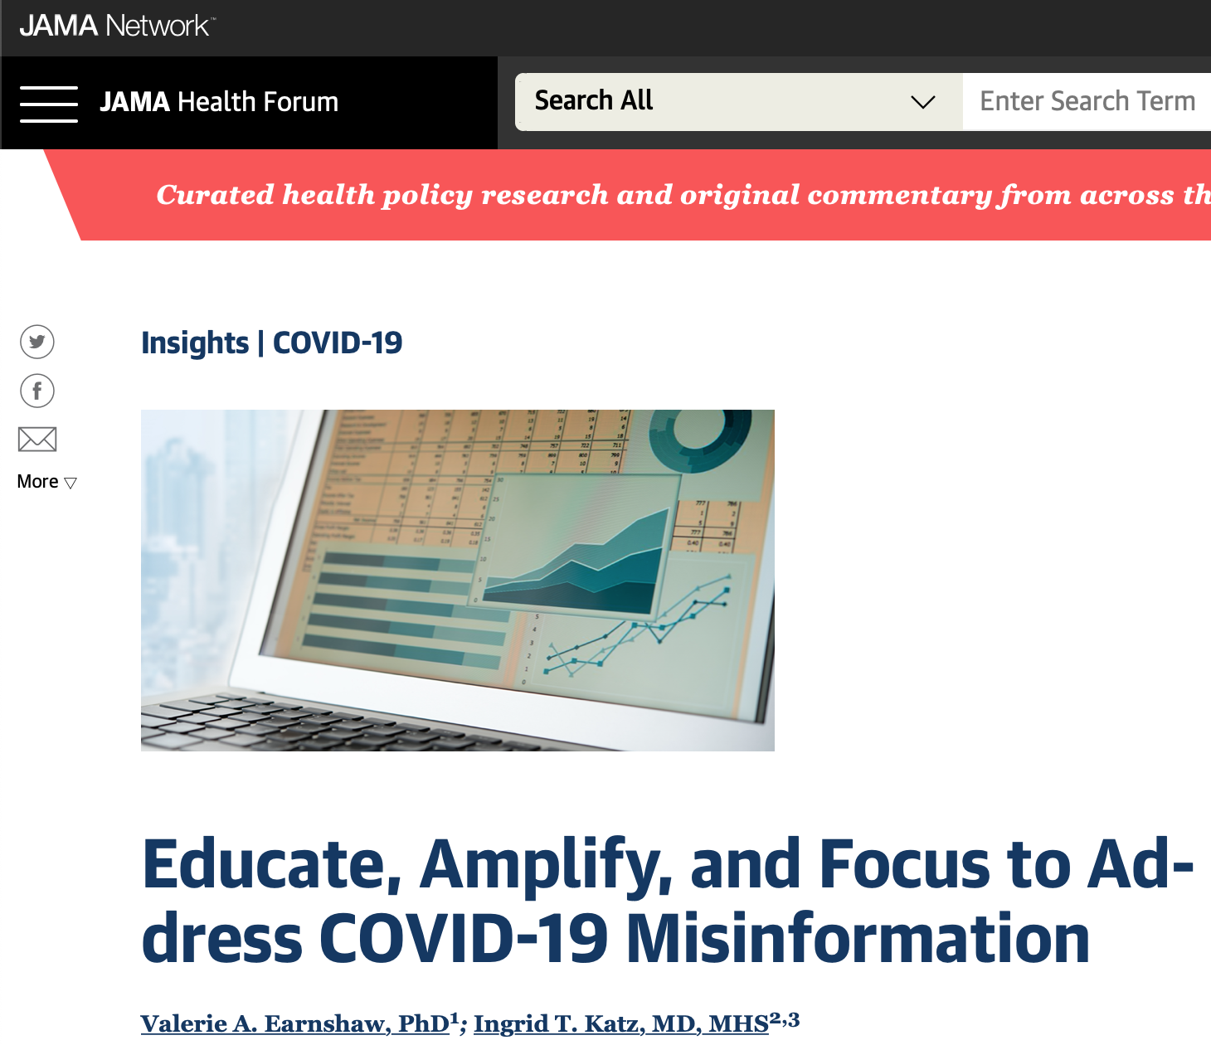
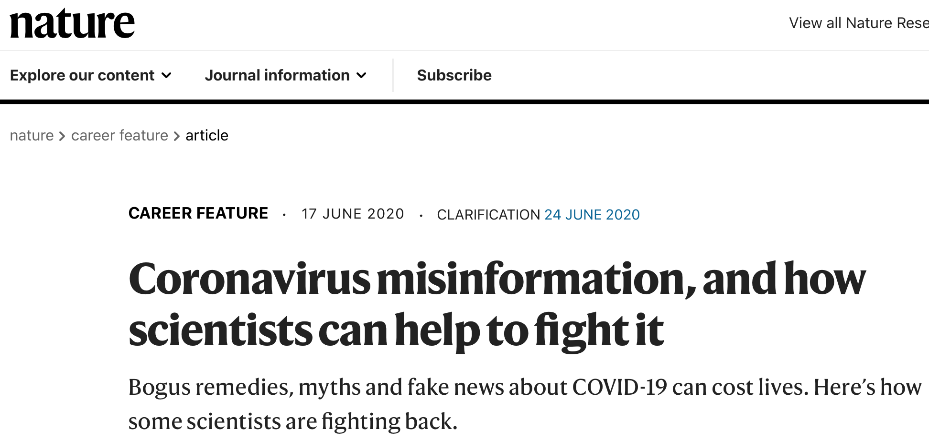
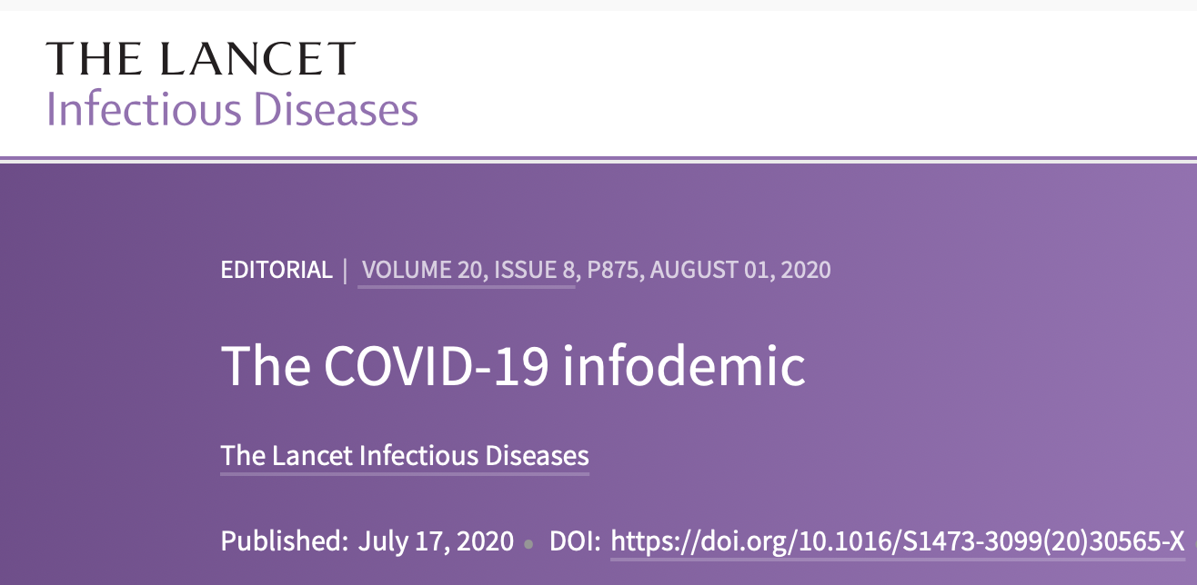
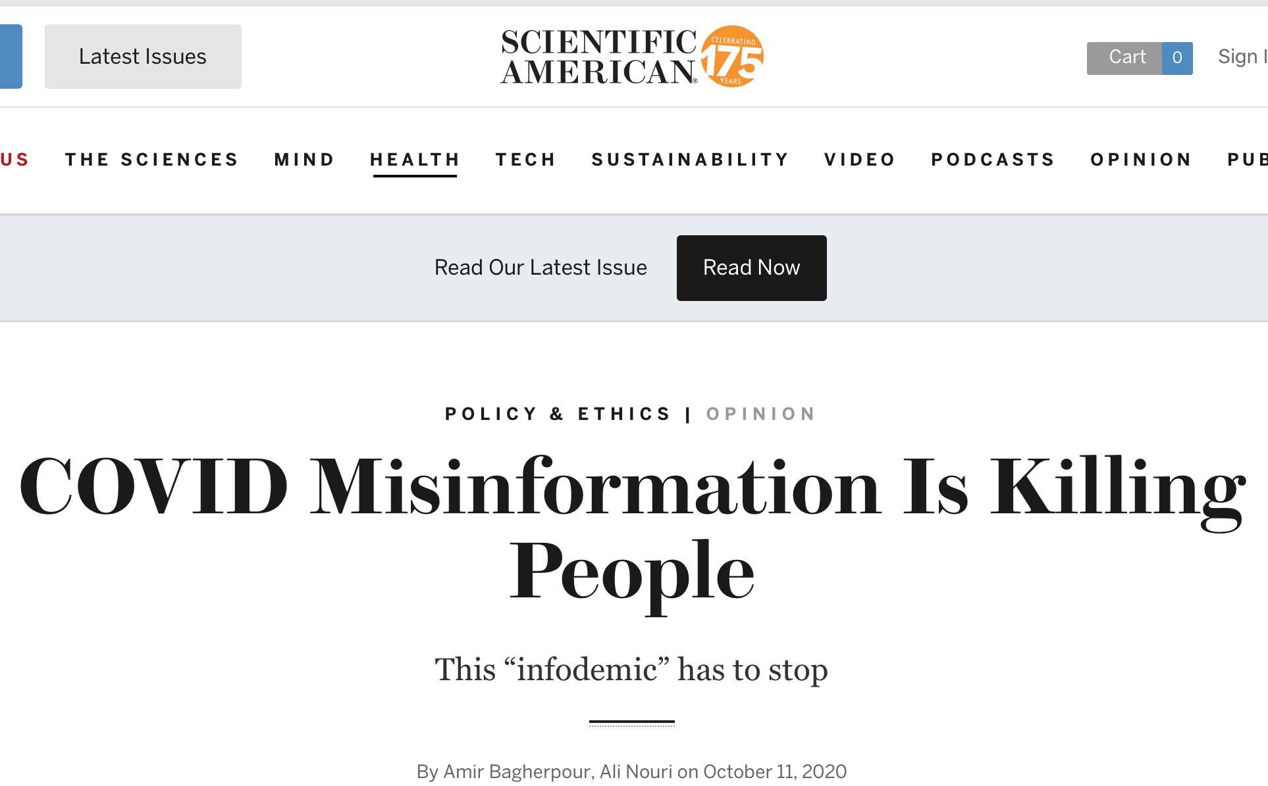
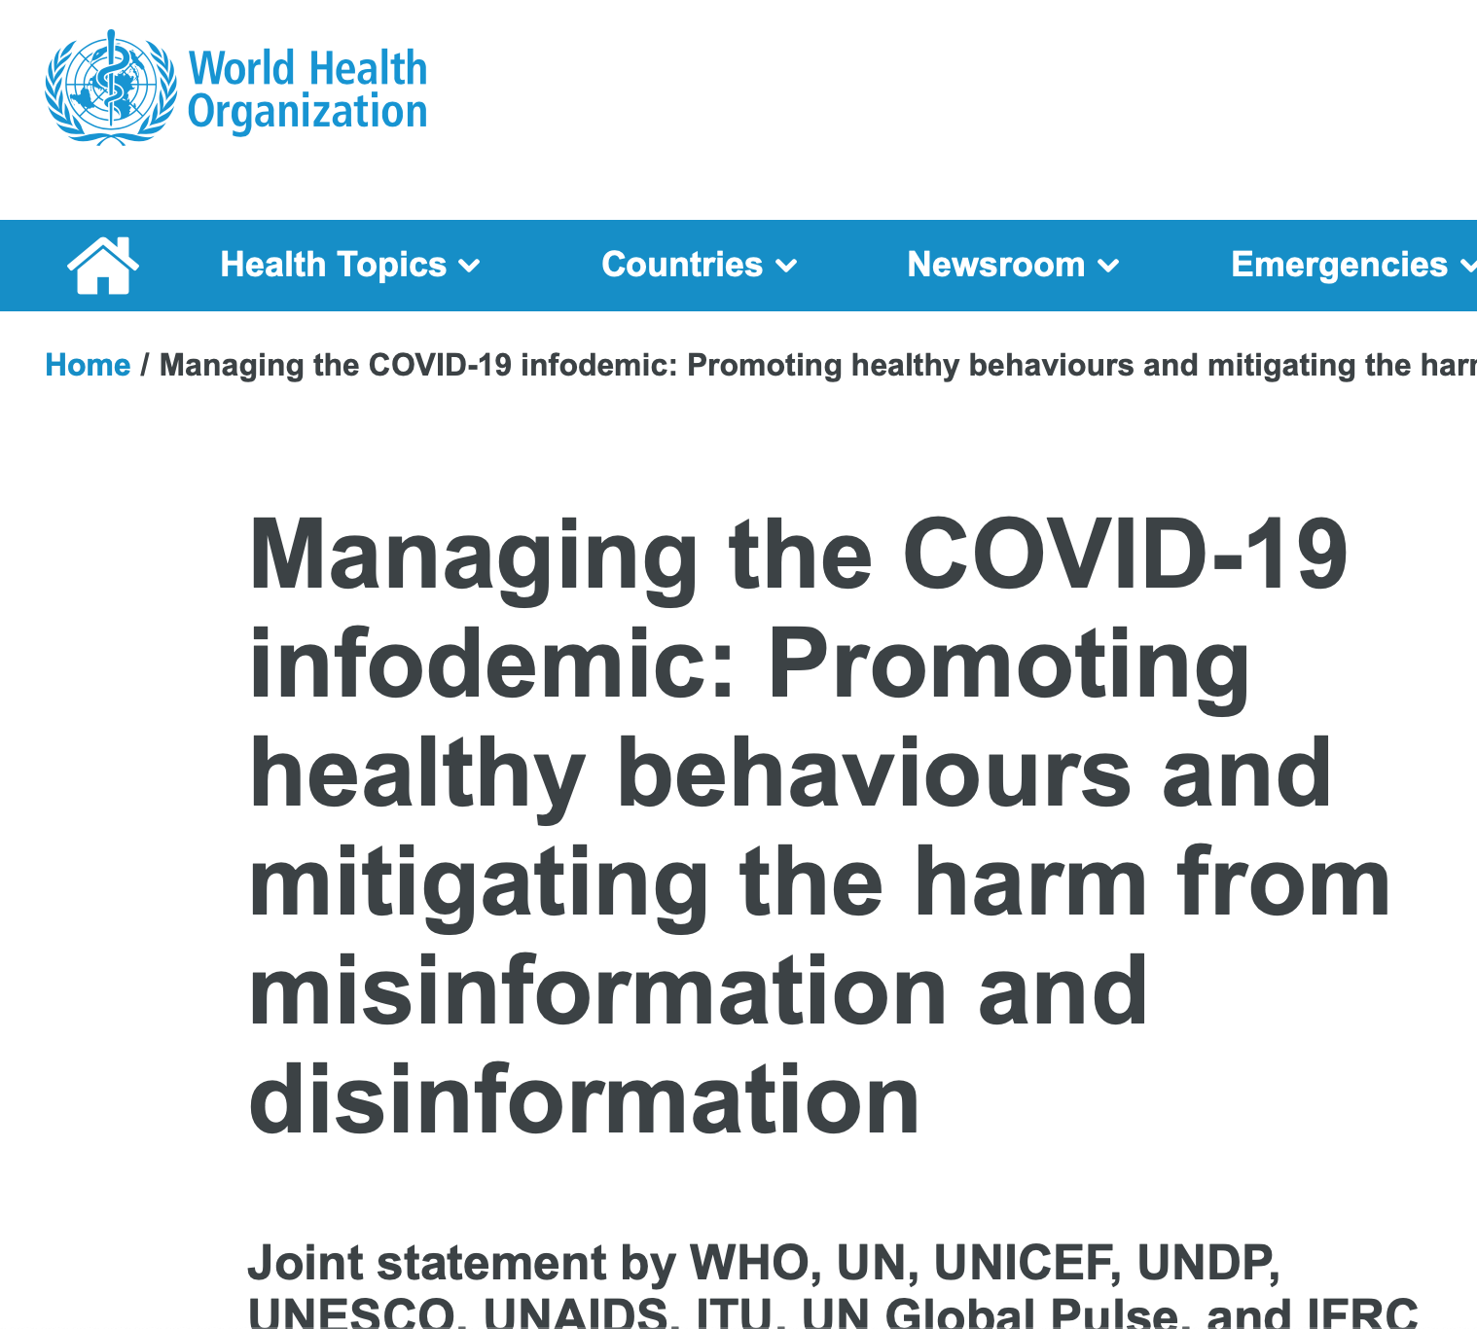
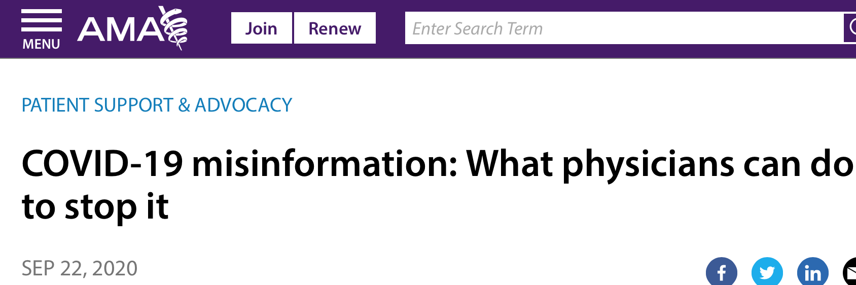

Slide 4
Why is Quality Information So Vital for the COVID-19 Pandemic?
Why is misinformation so dangerous for the COVID-19 pandemic?
Influences personal and group beliefs
Influences personal and group behaviors
Influences policies that govern populations

Slide 5
Examples During the COVID-19 Pandemic
Masks
Social Distancing
Treatments

Slide 6
Underlying Drivers
1. Individual liberties vs. public good.
2. Evolving nature of science.
3. Politicization of the virus.
4. Inconsistent approaches.

