Slide 1
Behavioral Medicine and COVID-19 Risk-Reduction: From Evidence to Practice
Ron O’Donnell, PhD
Sue Dahl-Popolizio, DBH, OTR/L
Chad Stecher, PhD
DISCLOSURES: THE PRESENTERS AND AFFILIATES OF THIS PRESENTATION HAVE NO RELEVANT FINANCIAL RELATIONSHIPS TO DISCLOSE

Slide 2
Learning Objectives
At the end of this presentation, participants will be able to:
Describe the role of lifestyle behaviors in contributing to higher risk of poor outcomes for patients infected with COVID19
Describe the impact of COVID19 on psychological distress and substance abuse
Identify common barriers to lifestyle behavior change in the context of COVID19 pandemic using the example of nutrition behavior change
Discuss actionable strategies to overcome these barriers

Slide 3
The issue...
‘those with NCDs are at higher risk of more severe symptoms and worse outcomes when they contract COVID19’
Addressing the behaviors through lifestyle choices of those with NCDs can reduce their risks

Slide 4
How do we obtain meaningful/sustainable behavior change?
Population Health Approach:
Maximize self-management of populations across NCDs
Develop community-based self-management intervention programs
Self-management - emphasizes patient responsibility with integrated provider support beyond simply educating
Providers help patients identify and overcome barriers to lifestyle change
Work with patients to find realistic solutions to address impediments to self-management of NCDs

Slide 5
Strategies
Self-management is multi-faceted and is dependent on patients managing their health issues within the context of their culture, values, living environment, and personal goals (SDOH). Providers must consider these issues in their treatment planning for adoption of new behaviors to occur (WHO, 2008)
Capitalize on the relationship!
Relationship between the patient and a trusted provider or contact person (can be staff, any provider type) in a practice is a strong factor facilitating behavior change to prevent NCD development, and can be leveraged to foster self-management of NCD
This relationship can reduce: fragmented care, overutilization of medical services, unresolved issues

Slide 6
How do we do this?
Primary care - provides a centralized setting for coordinating patient health and wellness, and addressing issues impeding this:
A primary factor limiting effective NCD management is poor communication =
Poor care coordination
Duplication of services
Contradiction of providers
Deficiencies in care
Lack of patient involvement in plan of care

Slide 7
Whole person care
Comprises patient’s physical, emotional, and social in the context of their past, present, and future life context/concerns (WHO, 2008)
Addressing lifestyle choices and behaviors that affect NCDs in the context of the patient’s own habits, roles, routines, can considering family, community environment, culture, and value system will improve success and sustainability of behavior change

Slide 8
Examples
Nutrition - to achieve behavior change, approach eating as an experience - incorporate education re: nutrition into the activity
Determine patient values/beliefs/culture related to food, and any barriers they identify. Do they like to eat alone or with others? What affects their food choices (weather, stress, family encounters, etc.)
Cooking group (possible activity) - a group fosters relationships - learning, support - increases likelihood of sustainability
First step can be choosing a meal/item - learn about nutrition, food labels, how meal/item makes us feel/affects our energy (e.g. pasta, vs chicken)
Plan all aspects (meal schedule, vegetables, protein types, wine with meal, etc.) and build on each experience

Slide 9
Nutrition
Patient is involved in all aspects (writing shopping list, shopping, choosing cookware/utensils, sides, drinks, where to eat, whom to eat with, etc.)
If patient is resistant to change, you may be able to use stepped change.
Examples:
Won’t give up whole milk: gradually mix whole milk with nonfat until the patient is used to the nonfat milk straight (if not full nonfat, anything along the continuum will be better than full fat)
Won’t give up sweet cereal: gradually mix regular cheerios into honey nut cheerios until used to the less sugary version
Gamification (use of apps, games re: food labels, quizzes, etc.) in some cases competition with self or others can facilitate sustaining behavior change

Slide 10
Nudging Healthier Behaviors
Basic theory is that rational decision making is subject to predictable biases:
Present-biased preferences
Status quo/default bias
Social norms
Overestimating small probabilities
Small changes in your environment/choice architecture can “improve” decision-making without restricting options:
Small incentives (weight loss [Volpp et al., 2008] and physical activity [King et al., 2014])
Updated defaults (retirement savings [Carroll et al., 2009]; organ donation [Abadie & Gay 2006])
Social comparisons (energy conservation [Allcott, 2011])
Planning and reminders (vaccinations [Milkman et al., 2011])
Notes:
Some of the unique challenges to empirically estimating the gains from team experience are self-selection into teams and self-selection into industries which are two important sources of time-invariant and time-varying omitted variables. To address these identification challenges:
Early evidence for the productivity gains from team experience in the workplace come from studies of team-based incentives. Daniel Hansen finds team-based incentives increased the productivity of the least productive workers, while the performance of the most productive workers did not change in a large financial company. Then Hamilton and co-authors showed that team-based incentives increased the productivity of sewers in a garment factory, where heterogenous treatment effect analyses support a mutual learning model in which more able works teach their less able colleagues to be more productive; comparison of team vs individual incentives within same firms
The peer effects literature has also documented significant gains from team experience in the settings of medical science researchers and teachers; quasi-random change in peers
Finally, and most similar to this estimation approach, Emily Nix has a current working paper that estimates the spillovers from peers’ education on a worker’s own wages using multiple levels of fixed effects: here on firms, worker, and time fixed effects
In the healthcare setting, this estimation strategy was recently used by Yiqun Chen’s JMP which similarly examine the gains from team experience in performing heart procedures using a two-way fixed effects design. That is, after estimating proceduralist and physician fixed effects, which capture time-invariant characteristics of the doctors and doctor-patient sorting effects, Chen estimates the effect of shared experience by the number of times that proceduralists and physicians work together on PCI or CABG.
This paper uses a similar approach to estimating the gains from team experience, where we are considering physicians and nurses or technicians, on heart procedures….
CABG – coronary artery bypass grafting – new artery vs. stenting to open blockage (less invasive, shorter procedure, lower immediate risk, but larger chance of revascularization)
Learning by doing:
LEVITT, S. D., J. A. LIST, AND C. SYVERSON (2013): “Toward an Understanding of Learn-
ing by Doing: Evidence from an Automobile Assembly Plant,” Journal of Political Econ-
omy, 121(4), 643–681.

Slide 11
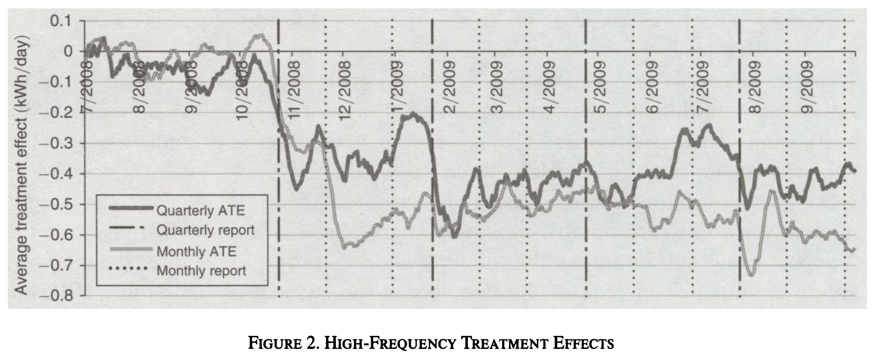
Some Nudges Yield Persistent Behavioral Change
Source: Allcott (2011)

Slide 12
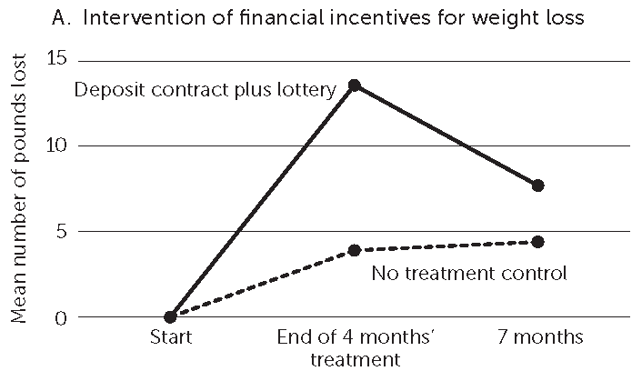
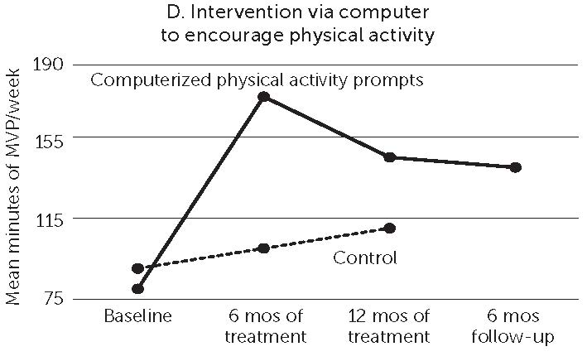
Not All Nudges Have Long-term Effects
Sources: Volpp et al. (2008) [left] and King et al. (2014) [right]

Slide 13
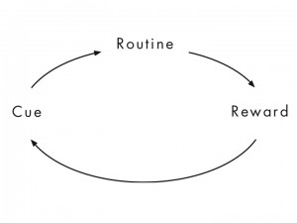
Behavioral Automaticity and “Habits”
Source: Duhigg (2012)

Slide 14
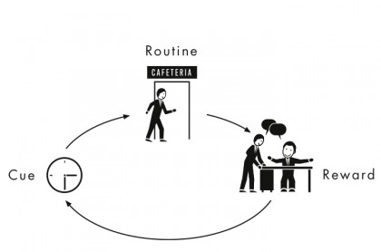
Behavioral Automaticity and “Habits” (example)
Source: Duhigg (2012)

Slide 15
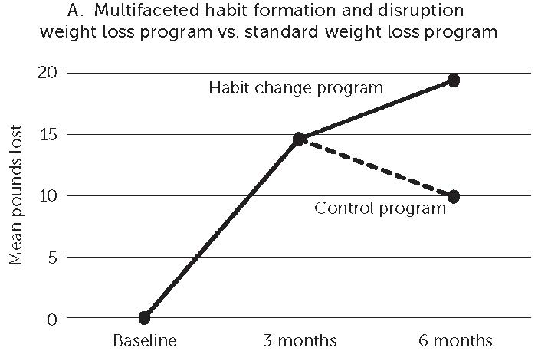
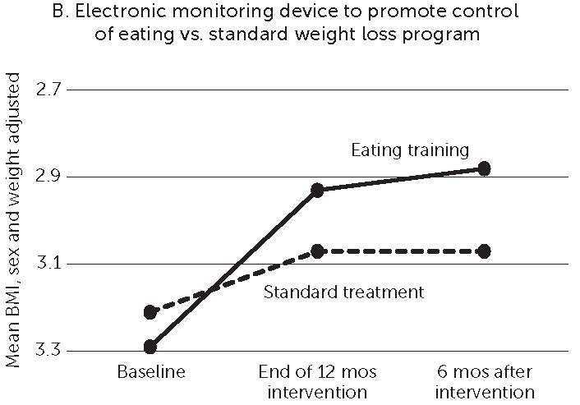
Habit-based Interventions Increase Persistence
Source: Wood & Neal (2016)

Slide 16
Healthier Habits in the Time of COVID
Many of our daily routines/cues have been change, potentially leading to new, less healthy habits:
Less physical activity
Poorer diets; more caffeine; limited dietary diversity
Social isolation; higher stress and anxiety
Cue disruption also provides an opportunity to build new habits (Wood & Neal, 2016)
Understand that your habits need to be rewired for these new cues
Notes:
Some of the unique challenges to empirically estimating the gains from team experience are self-selection into teams and self-selection into industries which are two important sources of time-invariant and time-varying omitted variables. To address these identification challenges:
Early evidence for the productivity gains from team experience in the workplace come from studies of team-based incentives. Daniel Hansen finds team-based incentives increased the productivity of the least productive workers, while the performance of the most productive workers did not change in a large financial company. Then Hamilton and co-authors showed that team-based incentives increased the productivity of sewers in a garment factory, where heterogenous treatment effect analyses support a mutual learning model in which more able works teach their less able colleagues to be more productive; comparison of team vs individual incentives within same firms
The peer effects literature has also documented significant gains from team experience in the settings of medical science researchers and teachers; quasi-random change in peers
Finally, and most similar to this estimation approach, Emily Nix has a current working paper that estimates the spillovers from peers’ education on a worker’s own wages using multiple levels of fixed effects: here on firms, worker, and time fixed effects
In the healthcare setting, this estimation strategy was recently used by Yiqun Chen’s JMP which similarly examine the gains from team experience in performing heart procedures using a two-way fixed effects design. That is, after estimating proceduralist and physician fixed effects, which capture time-invariant characteristics of the doctors and doctor-patient sorting effects, Chen estimates the effect of shared experience by the number of times that proceduralists and physicians work together on PCI or CABG.
This paper uses a similar approach to estimating the gains from team experience, where we are considering physicians and nurses or technicians, on heart procedures….
CABG – coronary artery bypass grafting – new artery vs. stenting to open blockage (less invasive, shorter procedure, lower immediate risk, but larger chance of revascularization)
Learning by doing:
LEVITT, S. D., J. A. LIST, AND C. SYVERSON (2013): “Toward an Understanding of Learn-
ing by Doing: Evidence from an Automobile Assembly Plant,” Journal of Political Econ-
omy, 121(4), 643–681.

Slide 17
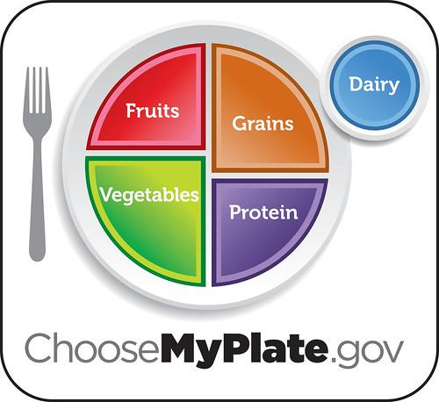
From calorie counting to MyPlate

Slide 18
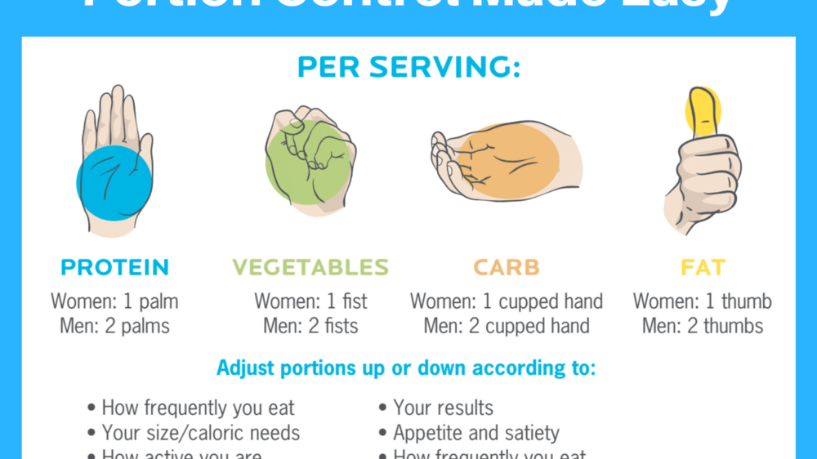
Precision Nutrition Portion Size

Slide 19
Atomic Habits Laws

Slide 20
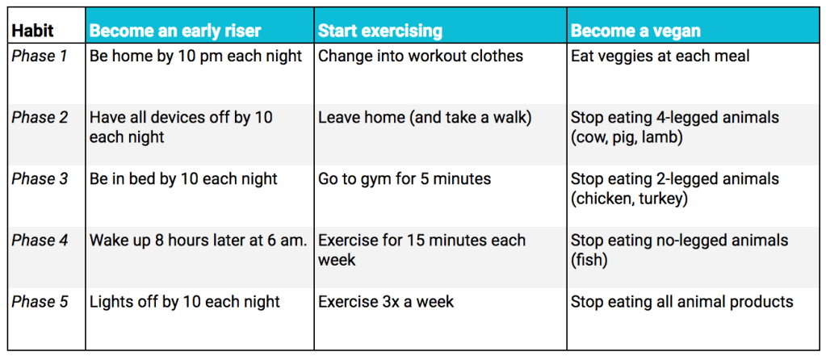
Habit Shaping

Slide 21
Habit Stacking

Slide 22
Health Technologies and Habit Change
Smartphone apps
Gamification for nutrition
Food label scanners
AI based gadgets
http://helloegg.net
https://www.nutribulletbalance.com/
https://hidratespark.com/products/hidrate-spark-2-0
http://www.blueprintfit.com/
https://www.thefoodpsychologyclinic.co.uk/

Slide 23
Conclusions
NCD’s, lifestyle increase risk of adverse COVID19 outcomes
COVID19 stress increases psychological distress, substance use, and lifestyle behaviors
Population health and patient-clinician relationship central
Emerging innovations in habit change seem well-suited to telehealth and use of health technologies

Slide 24
Thank you!
Ron O’Donnell, PhD
Sue Dahl-Popolizio, DBH, OTR/L
Chad Stecher, PhD

