Slide 1
Let’s Talk Anti-Inflammatory Foods and Immune Function
Chrissy Barth, MS, RDN, RYT
Lecturer, College of Health Solutions

Slide 2
Our health begins in the gut!
Microbiome = microorganisms that live in the digestive tract
Bacteria, microbes, fungi, and viruses
Number
100 trillion bacteria in and on our bodies (90% in large intestine)
Bacterial cells outnumber human cells 10 to 1.
We are 90% bacteria!
Introduction to the Human Microbiome. American Microbiome Institute.

Slide 3
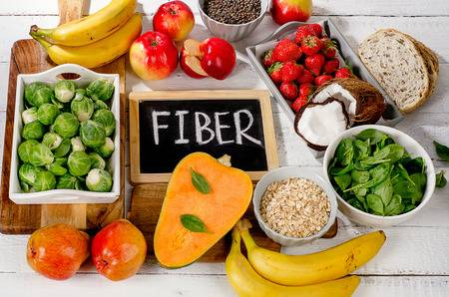
Feed your flora with fiber
Gut bacteria eat (fermented) fiber.
Whole plant foods are the main sources of fiber:
Fruits and veggies
Whole grains
Legumes, nuts and seeds
Link between a high fiber diet (~25-35gm) and a reduced risk of:
Obesity
Heart disease
Cancer

Slide 4
Inflammation, polyphenols, and gut bacteria
Less inflammation a healthier gut
Polyphenols (plant-based antioxidant compounds)
Anti-inflammatories
Gut bacteria promote polyphenol absorption
Polyphenols promote growth and diversity of healthy microbiome
Polyphenol Sources:
Plant foods: veggies, fruits, whole grains, nuts, beans, seeds
Herbs + spices: turmeric, ginger, cinnamon, oregano, and rosemary
Others: tea, coffee, dark chocolate, red wine, and EVOO
Hussain, T., Tan, B., Yin, Y., Blachier, F., Tossou, M. C., & Rahu, N. (2016). Oxidative Stress and Inflammation: What Polyphenols Can Do for Us?. Oxidative medicine and cellular longevity, 2016, 7432797. https://doi.org/10.1155/2016/7432797

Slide 5
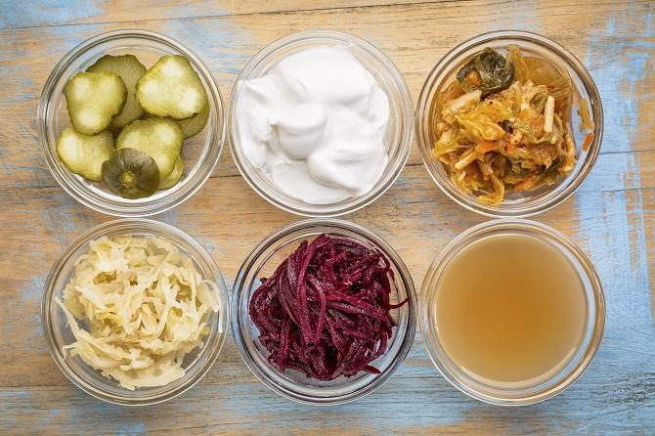
Fermented foods
Fermented foods may act as natural probiotics
Fermentation is a traditional way of preserving food
Fermented foods include:
Dairy: yogurt, kefir
Vegetables: sauerkraut, kimchi, pickles
Soy: miso, tempeh
Other: apple cider vinegar
Jijon H, Backer J, Diaz H, Yeung H, Thiel D, McKaigney C, De Simone C, Madsen K. DNA from probiotic bacteria modulates murine and human epithelial and immune function. Gastroenterology. 2004 May;126(5):1358-73. doi: 10.1053/j.gastro.2004.02.003. PubMed PMID: 15131797.

Slide 6
Vitamin D – Important regulator of the immune system
Vitamin D deficiency is common (42% of U.S. population)
May alter the gut microbiome
Associated with increased inflammation in the gut
Sources of vitamin D
Sunlight
Food: fatty fish, egg yolks, fortified foods (milk, dairy alternatives, and cereal) + sun-bathed mushrooms
Supplementation
Bottom line: know your Vitamin D status
The Impact of Vitamin D Levels on Inflammatory Status: A Systematic Review of Immune Cell Studies. PLoS One. 2015 Nov 3;10(11):e0141770. doi: 10.1371/journal.pone.0141770.

Slide 7
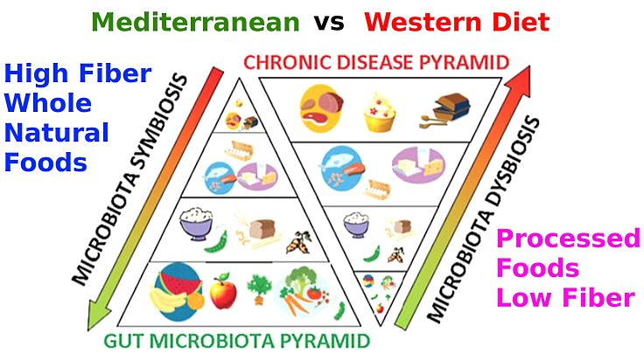
Summary: Feed your flora nutrition tips
Eat a whole foods based diet that includes good sources of fiber.
Consume at least 30 different plant species each week.
Include fermented foods in your diet.
Limit intake of highly processed foods.
Avoid artificial sweeteners.
“Eat food. Not too much. Mostly plants.”
~Michael Pollan

Slide 8
Summary:
“Let food be thy medicine and medicine be thy food” ~Hippocrates

