Slide 1
COVID-19 vaccine: hesitancy & addressing concerns

Slide 2
Agenda
1) Current COVID-19 vaccines
2) Vaccine hesitancy & acceptability spectrum
3) Vaccine fears and drivers of mistrust
4) Addressing these concerns
5) Increasing vaccine acceptance

Slide 3
COVID-19 vaccines
Johnson & Johnson
EUA: Under review
What is in it? Altered cold virus (adenovirus 26)
Efficacy: 66%
For: Age 18+
Doses: 1
Refrigerated
(not frozen)
Pfizer
EUA : Granted
What is in it? mRNA
Efficacy: 95%
For: Age 16+
Doses: 2
Timing: 21 days apart
Requires -70◦ storage
Moderna
EUA: Granted
What is in it? mRNA
Efficacy: 94%
For: Age 18+
Doses: 2
Timing: 28 days apart
Requires -20◦ storage

Slide 4
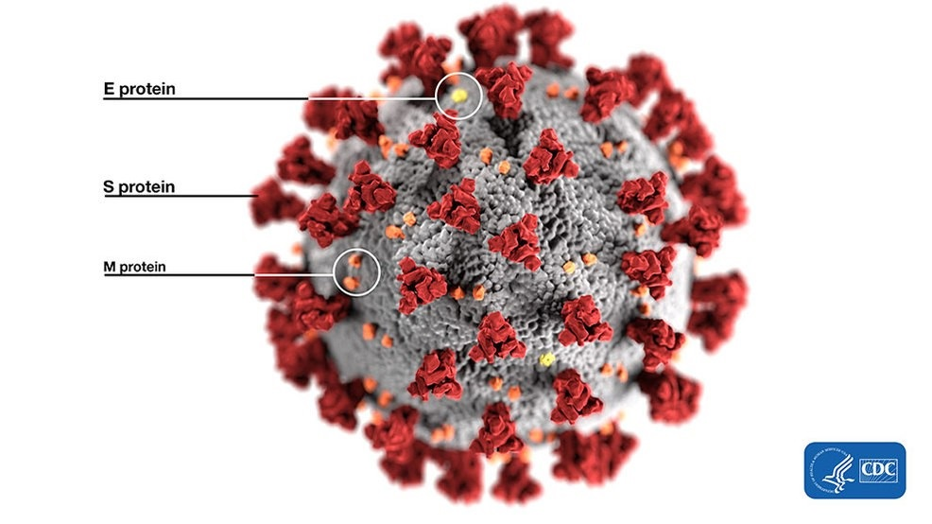
mRNA vaccines
Spike protein is on surface of virus that causes COVID-19
mRNA gives instructions on how to make a spike protein
Cells make protein piece, and immune system recognizes that this is an “outsider” and begins creating antibodies to fight off future infection.
This vaccine trains our body to recognize COVID-19 and respond to it (kill the virus) before you get sick
https://www.cdc.gov/coronavirus/2019-ncov/vaccines/differnt-vaccines/mrna.html
Notes:
mRNA Vaccines Are New, But Not Unknown
Researchers have been studying and working with mRNA vaccines for decades. Interest has grown in these vaccines because they can be developed in a laboratory using readily available materials. This means the process can be standardized and scaled up, making vaccine development faster than traditional methods of making vaccines.
mRNA vaccines have been studied before for flu, Zika, rabies, and cytomegalovirus (CMV). As soon as the necessary information about the virus that causes COVID-19 was available, scientists began designing the mRNA instructions for cells to build the unique spike protein into an mRNA vaccine.
Future mRNA vaccine technology may allow for one vaccine to provide protection for multiple diseases, thus decreasing the number of shots needed for protection against common vaccine-preventable diseases.
Beyond vaccines, cancer research has used mRNA to trigger the immune system to target specific cancer cells.

Slide 5
Leask J, Kinnersley P, Jackson C, Cheater F, Bedford H, Rowles G. Communicating with parents about vaccination: a framework for health professionals. BMC Pediatrics. 2012;12(1):154.
Notes:
Literature review to identify a spectrum of parent attitudes or ‘positions’ on childhood vaccination with estimates of the proportion of each group based on population studies. Development of a framework related to each parental position with determination of key indicators, goals and strategies based on communication science, motivational interviewing and valid consent principles.
Results
Five distinct parental groups were identified: the ‘unquestioning acceptor’ (30–40%), the ‘cautious acceptor’ (25–35%); the ‘hesitant’ (20–30%); the ‘late or selective vaccinator’ (2–27%); and the ‘refuser’ of all vaccines (<2%). The goals of the encounter with each group will vary, depending on the parents’ readiness to vaccinate. In all encounters, health professionals should build rapport, accept questions and concerns, and facilitate valid consent. For the hesitant, late or selective vaccinators, or refusers, strategies should include use of a guiding style and eliciting the parent’s own motivations to vaccinate while, avoiding excessive persuasion and adversarial debates. It may be necessary to book another appointment or offer attendance at a specialised adverse events clinic. Good information resources should also be used.
Conclusions
Health professionals have a central role in maintaining public trust in vaccination, including addressing parents’ concerns. These recommendations are tailored to specific parental positions on vaccination and provide a structured approach to assist professionals. They advocate respectful interactions that aim to guide parents towards quality decisions.

Slide 6
https://www.pewresearch.org/science/2020/12/03/intent-to-get-a-covid-19-vaccine-rises-to-60-as-confidence-in-research-and-development-process-increases/
Notes:
Overall, 60% of Americans say they would definitely or probably get a vaccine for the coronavirus, if one were available today, up from 51% who said this in September. About four-in-ten (39%) say they definitely or probably would not get a coronavirus vaccine, though about half of this group – or 18% of U.S. adults – says it’s possible they would decide to get vaccinated once people start getting a vaccine and more information becomes available.

Slide 7
Why do people want the vaccine?
Personal concern
Trust in vaccines
Personal vaccine practices
https://www.pewresearch.org/science/2020/12/03/intent-to-get-a-covid-19-vaccine-rises-to-60-as-confidence-in-research-and-development-process-increases/
Notes:
Personal concern – Does the fear of illness outweigh the fear of the vaccine?
Trust: Do people trust the scientific process?
Personal practices: Do people usually get the flu vaccine? Do they do it for self-protection? Protecting others?
Personal concern about getting a case of COVID-19 that would require hospitalization. Those most concerned about getting a serious case of the coronavirus indicate a higher likelihood of getting a vaccine. Those who see little personal need by this metric are closely divided over whether they would get vaccinated.
Trust in the vaccine development process. Expressing confidence that the research and development process will yield a safe and effective vaccine is tied to higher levels of intent to get vaccinated.
Personal practices when it comes to other vaccines. Those who say they get a flu shot yearly are much more likely than those who rarely or never do so to say they would get a vaccine for the coronavirus if one were available.

Slide 8
Why do some people not want the vaccine?
Notes:
About a quarter (27%) of the public remains vaccine hesitant, saying they probably or definitely would not get a COVID-19 vaccine even if it were available for free and deemed safe by scientists.
Vaccine hesitancy is highest among
Republicans (42%),
those ages 30-49 (36%),
and rural residents (35%).
Importantly, 35% of Black adults (a group that has borne a disproportionate burden of the pandemic) say they definitely or probably would not get vaccinated, as do one third of those who say they have been deemed essential workers (33%) and three in ten (29%) of those who work in a health care delivery setting .

Slide 9
Vaccine-related Fears
COVID-19 vaccines
General vaccines
Fear of side effects / safety
Developed too quickly and not tested thoroughly enough
Influence of politics
Perceived cost
Perception that it is unnecessary
Conspiracy theories
Social control
Bill Gates and the 5G Network
Fear of needles
Lack of trust in science
Fear of side effects
Personal cost for pharmaceutical companies’ gains
Lead to infertility? (No)
Lead to autism (No)
Kaiser Family Foundation, December 2020
https://www.kff.org/coronavirus-covid-19/report/kff-covid-19-vaccine-monitor-december-2020/

Slide 10
COVID-19 vaccine side effects
Mild- moderate
pain at the site of the injection
fatigue
fever
headache
chills
muscle and/or joint pains
nausea & vomiting
swollen lymph nodes in the arm
Severe Allergic reactions
Sources for this information:
Mayo Clinic
Harvard Medical School
WebMD

Slide 11
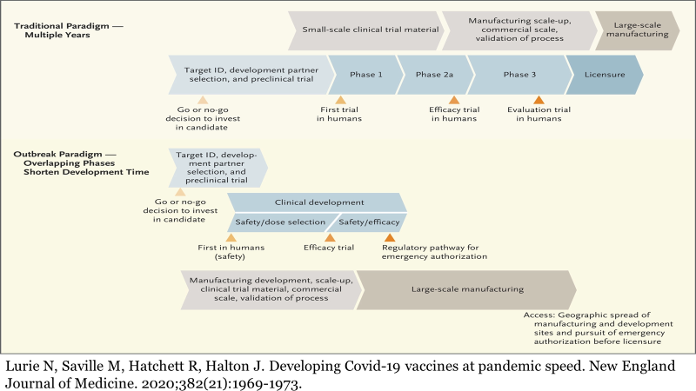
Scientists did not skip clinical trial stages.

Slide 12
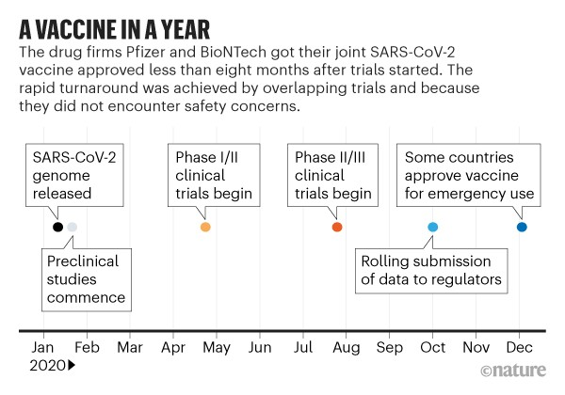
Pandemic + Financial Investment + Technology = Vaccine
Ball, P. The lightning-fast quest for COVID vaccines – and what it means for other diseases. Nature. (2021). 589: 16-18.

Slide 13
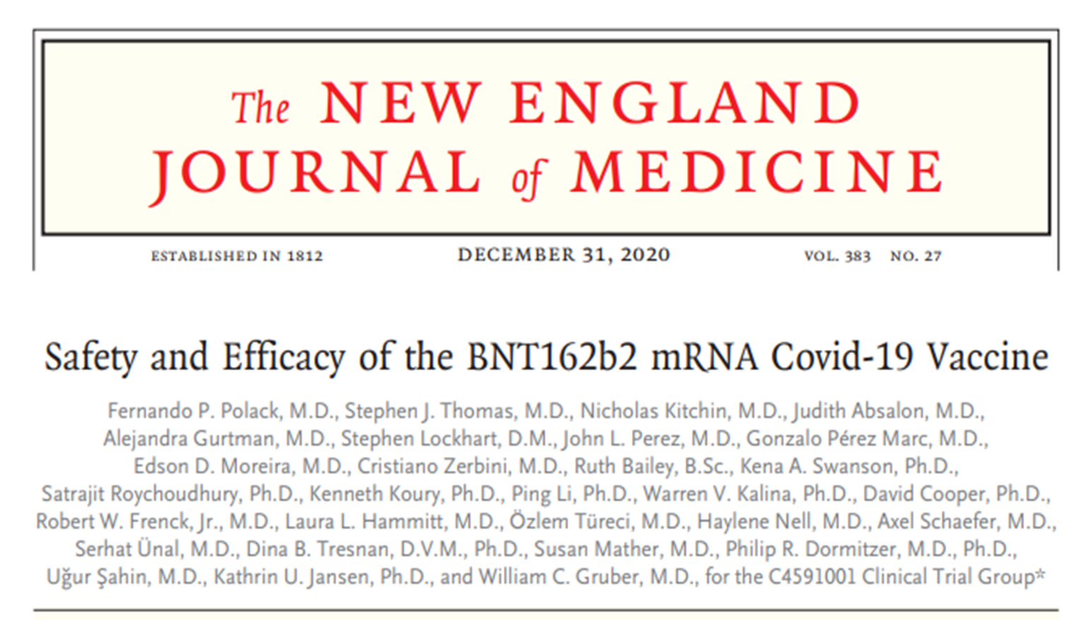
Pfizer vaccine
21,720 received vaccine
21,728 received placebo
Polack FP, Thomas SJ, Kitchin N, et al. Safety and efficacy of the BNT162b2 mRNA Covid-19 vaccine. New England Journal of Medicine. 2020;383(27):2603-2615.
Notes:
BACKGROUND
Severe acute respiratory syndrome coronavirus 2 (SARS-CoV-2) infection and the
resulting coronavirus disease 2019 (Covid-19) have afflicted tens of millions of people
in a worldwide pandemic. Safe and effective vaccines are needed urgently.
METHODS
In an ongoing multinational, placebo-controlled, observer-blinded, pivotal efficacy
trial, we randomly assigned persons 16 years of age or older in a 1:1 ratio to receive
two doses, 21 days apart, of either placebo or the BNT162b2 vaccine candidate (30 μg
per dose). BNT162b2 is a lipid nanoparticle–formulated, nucleoside-modified RNA
vaccine that encodes a prefusion stabilized, membrane-anchored SARS-CoV-2 full-length spike protein.
The primary end points were efficacy of the vaccine against
laboratory-confirmed Covid-19 and safety.
RESULTS
A total of 43,548 participants underwent randomization, of whom 43,448 received
injections: 21,720 with BNT162b2 and 21,728 with placebo. There were 8 cases of
Covid-19 with onset at least 7 days after the second dose among participants assigned to receive BNT162b2 and 162 cases among those assigned to placebo;
BNT162b2 was 95% effective in preventing Covid-19 (95% credible interval, 90.3 to
97.6). Similar vaccine efficacy (generally 90 to 100%) was observed across subgroups
defined by age, sex, race, ethnicity, baseline body-mass index, and the presence of
coexisting conditions. Among 10 cases of severe Covid-19 with onset after the first
dose, 9 occurred in placebo recipients and 1 in a BNT162b2 recipient. The safety
profile of BNT162b2 was characterized by short-term, mild-to-moderate pain at the
injection site, fatigue, and headache. The incidence of serious adverse events was
low and was similar in the vaccine and placebo groups.
CONCLUSIONS
A two-dose regimen of BNT162b2 conferred 95% protection against Covid-19 in
persons 16 years of age or older. Safety over a median of 2 months was similar to
that of other viral vaccines

Slide 14
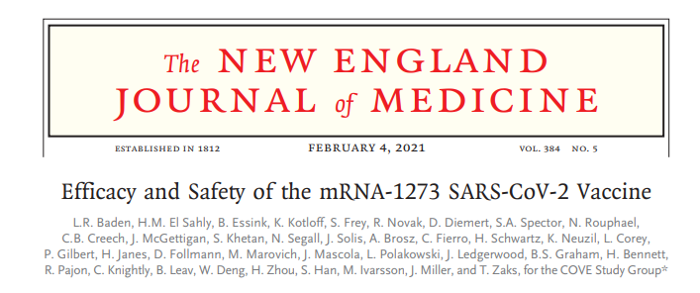
Moderna Vaccine
15,210 received vaccine
15,210 received placebo
Baden LR, El Sahly HM, Essink B, et al. Efficacy and safety of the mRNA-1273 SARS-CoV-2 vaccine. New England Journal of Medicine. 2020; 384(5): 403-416.
Notes:
BACKGROUND Vaccines are needed to prevent coronavirus disease 2019 (Covid-19) and to protect persons who are at high risk for complications. The mRNA-1273 vaccine is a lipid nanoparticle–encapsulated mRNA-based vaccine that encodes the prefusion stabilized full-length spike protein of the severe acute respiratory syndrome coronavirus 2 (SARS-CoV-2), the virus that causes Covid-19.
METHODS This phase 3 randomized, observer-blinded, placebo-controlled trial was conducted at 99 centers across the United States. Persons at high risk for SARS-CoV-2 infection or its complications were randomly assigned in a 1:1 ratio to receive two intramuscular injections of mRNA-1273 (100 μg) or placebo 28 days apart. The primary end point was prevention of Covid-19 illness with onset at least 14 days after the second injection in participants who had not previously been infected with SARS-CoV-2.
RESULTS The trial enrolled 30,420 volunteers who were randomly assigned in a 1:1 ratio to receive either vaccine or placebo (15,210 participants in each group). More than 96% of participants received both injections, and 2.2% had evidence (serologic, virologic, or both) of SARS-CoV-2 infection at baseline. Symptomatic Covid-19 illness was confirmed in 185 participants in the placebo group (56.5 per 1000 person years; 95% confidence interval [CI], 48.7 to 65.3) and in 11 participants in the mRNA1273 group (3.3 per 1000 person-years; 95% CI, 1.7 to 6.0); vaccine efficacy was 94.1% (95% CI, 89.3 to 96.8%; P

Slide 15
COVID-19 Vaccine Hesitancy (continued)
Fear of side effects
Developed too quickly
Influence of politics
Perceived cost of vaccine (It is free.)
Perception that it is unnecessary
Conspiracy theories
Social control
Bill Gates and the 5G Network
COVID-19 vaccines
Kaiser Family Foundation
https://www.kff.org/coronavirus-covid-19/report/kff-covid-19-vaccine-monitor-december-2020/

Slide 16
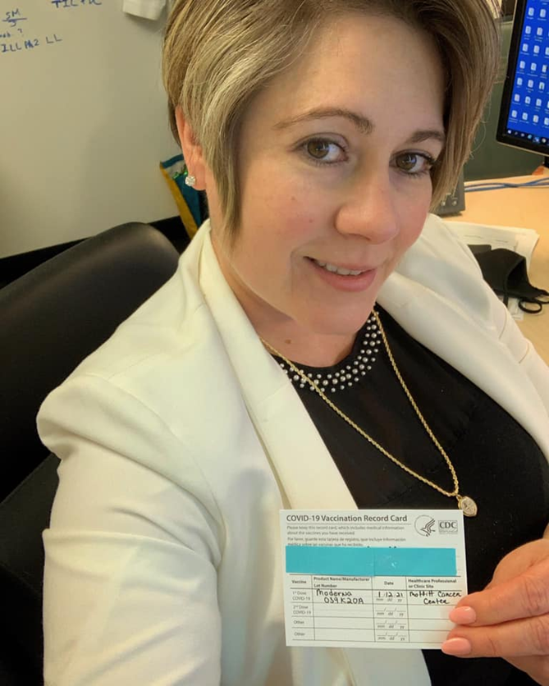
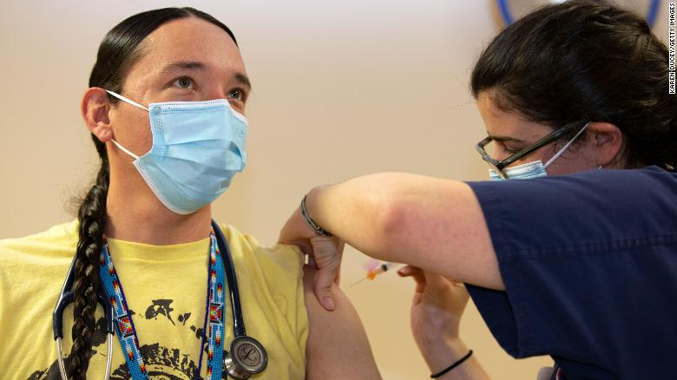
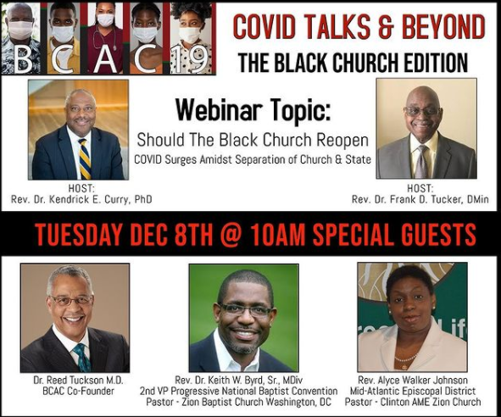
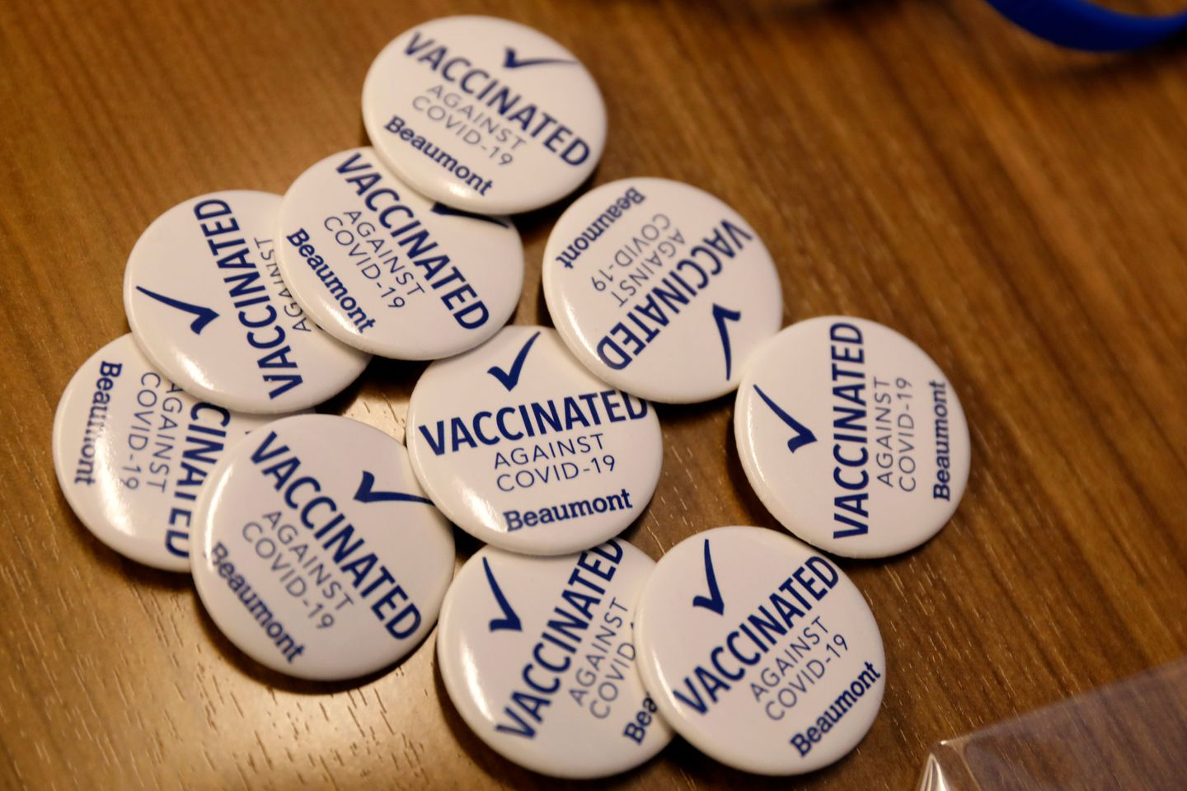
What works to increase vaccine acceptance?
Healthcare providers: Provide strong recommendation
Partner with trusted sources for your specific audience
Increase social norm to vaccinate
Community organizations
Influencers
Religious leaders
Notes:
Black Coalition Against COVID-19
H

Slide 17
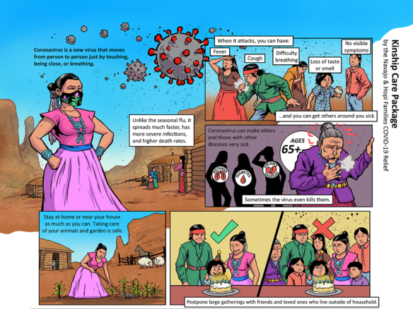
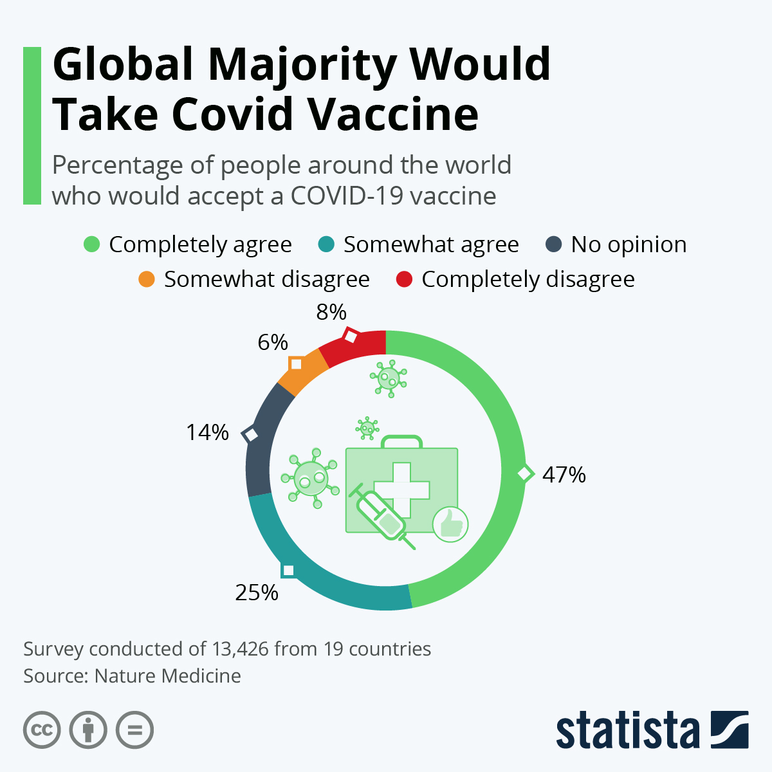
Additional Approaches
Storytelling
(Use narratives)
Share images/visuals, number, graphs
Chou WS, Burgdorf CE, Gaysynsky A, Hunter CM. COVID-19 vaccination communication... National Cancer Institute. https://obssr.od.nih.gov/wp-content/uploads/2020/12/COVIDReport_Final.pdf
Notes:
Black Coalition Against COVID-19
H

Slide 18
Tips for Communicating about COVID-19 (Journalist’s Resource; Author: Naseem Miller)
Segment your audience and find out why some are vaccine hesitant
Compassionately answer audiences’ questions about vaccines
Do not ignore vaccine side effects
Balance who is heard in your stories (will vaccinate, will not vaccinate)
Spend time in communities where the majorities of residents are racial/ethnic minorities and learn why vaccine uptake rates are lower
Talk to researchers and academics who study vaccine hesitancy
https://journalistsresource.org/studies/society/public-health/6-tips-for-covering-vaccine-hesitancy/
Notes:
A recent survey of 1,435 American Indians and Alaska Natives from the Urban Indian Health Institute found that 75% of participants were willing to get a Covid-19 vaccine, largely out of a sense of responsibility to protect their communities and preserve their cultures. That suggests that culturally relevant messaging is key to building vaccine acceptance among Native people, the report's authors wrote.

Slide 19
Additional Resources
Author: National Institutes of Health
Title: COVID-19 Vaccination* Communication: Applying behavioral and social …
Link: https://obssr.od.nih.gov/wp-content/uploads/2020/12/COVIDReport_Final.pdf
Author: Whitehouse.gov
Title: National Strategy for the COVID-19 Response and Pandemic Preparedness
Link: https://www.whitehouse.gov/wp-content/uploads/2021/01/National-Strategy-for-the-COVID-19-Response-and-Pandemic-Preparedness.pdf
Recommended podcasts:
Public Health on Call (JHU), Episode #s 213, 214, 229, 243
Coronavirus Q &A (JAMA), Episode from Feb. 15, 2021
This Podcast Will Kill You Episode from Dec. 22, 2020

